Slide 1

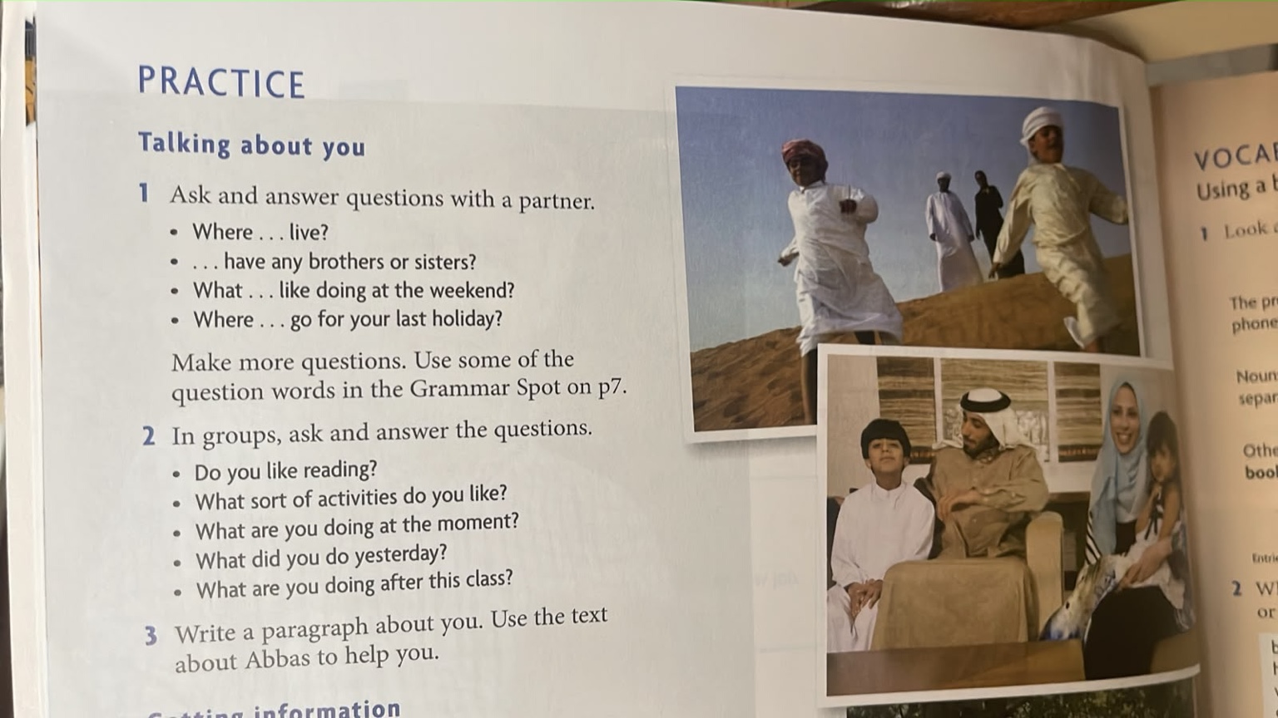
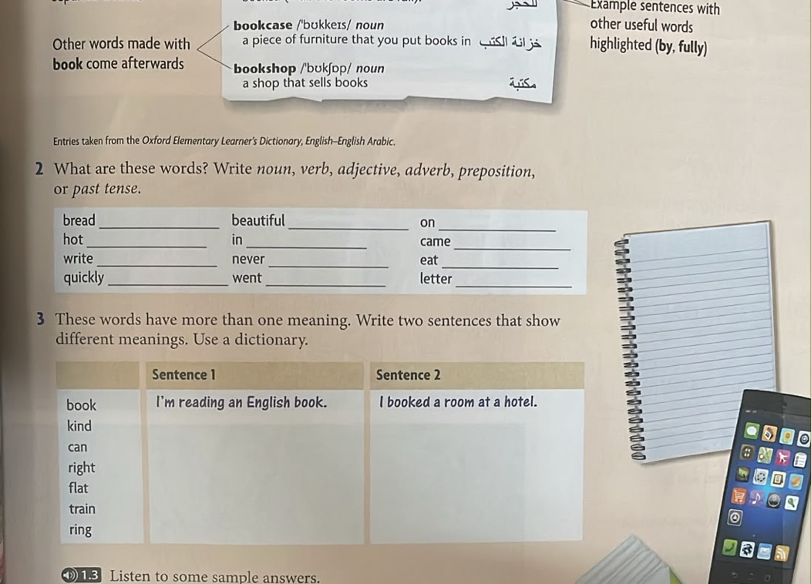
Unit 1
Getting to Know You
& Using a Bilingual Dictionary
Detailed lesson slides with Kagan cooperative structures and language-learning strategies.
Speaking
Vocabulary
Dictionary Skills
Unit 1 • Getting to know you
01
Notes:
Purpose: introduce the lesson sequence and set an interactive tone.
Teacher talk: Today we will practise talking about ourselves and learn how to use a bilingual dictionary accurately.
Kagan principle: students will speak often, with equal participation and partner accountability.
Language learning strategy focus: ask questions, infer meaning from examples, use dictionary information, and reflect on progress.

Slide 2

Learning outcomes & lesson flow
45–60 minute interactive lesson
By the end, learners can…
Lesson flow
• ask and answer personal questions
• use follow-up questions naturally
• identify noun, verb, adjective, adverb, preposition and past tense
• read a bilingual dictionary entry
• write a short paragraph about themselves
1. Warm-up: photo talk
2. Partner questions
3. Group speaking practice
4. Dictionary entry analysis
5. Word-class sort
6. Multiple meanings
7. Writing and exit ticket
Kagan: equal participation
Strategy: plan → practise → check
Unit 1 • Getting to know you
02
Notes:
Timing: 3 minutes. Share outcomes in student-friendly language.
Ask students to repeat the success criteria in pairs: “Today I can ask questions, use a dictionary, and write about myself.”
Kagan: explain that everyone will have a role and speaking time.
Language strategy: students keep a mini target: one speaking goal and one vocabulary goal.

Slide 3
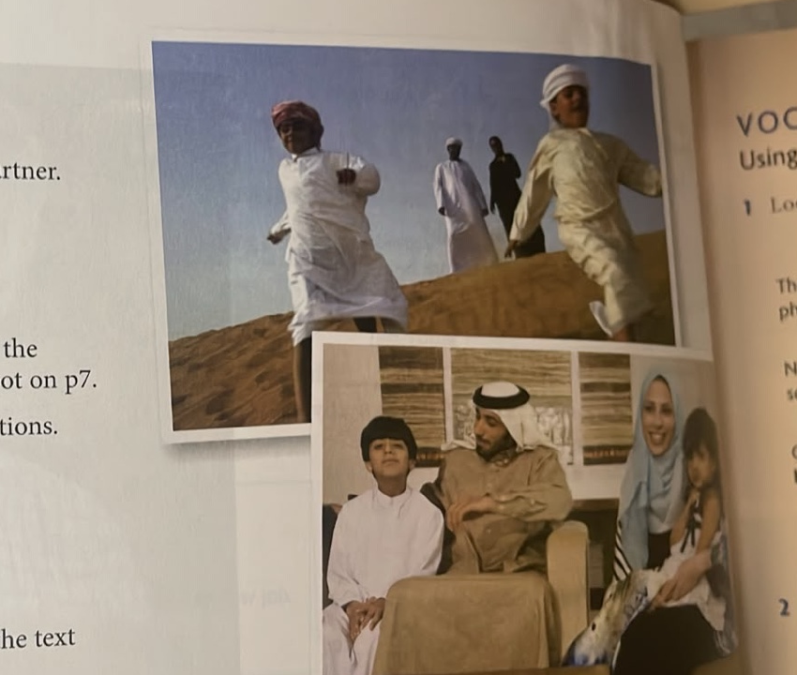
Starter: What can you say about the pictures?
Activate background knowledge before reading the exercise
Think silently
Useful language
Look at the people. What do you notice?
Where might they be?
What are they doing?
I can see…
They are…
He/She is…
I think they feel…
Pair share
Tell your partner 2 ideas.
Use: “I think…” / “Maybe…”
Share with class
One student reports a partner’s idea:
“My partner thinks…”
Kagan: Timed Pair Share
Strategy: use visual clues
Unit 1 • Getting to know you
03
Notes:
Timing: 5 minutes.
Kagan Timed Pair Share: Partner A speaks for 30 seconds, Partner B listens and thanks. Then switch.
Language learning strategy: compensation strategy — students use visual clues and expressions like “maybe” when they do not know exact words.
Teacher monitors for common errors with present continuous: “They are walking,” “He is sitting.”

Slide 4
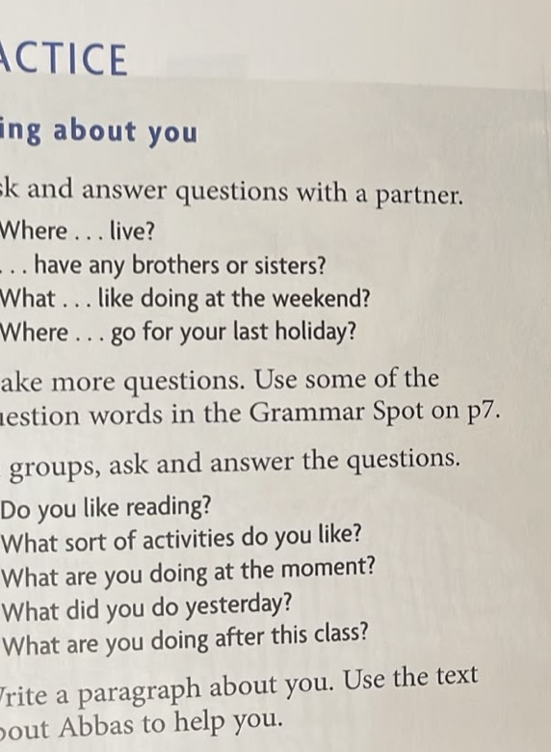
Talking about you: question bank
From controlled questions to natural conversation
Complete the questions
Question words
Where do you live?
Do you have any brothers or sisters?
What do you like doing at the weekend?
Where did you go for your last holiday?
Where
What
When
Who
Why
How
Add one follow-up
Example:
A: Where do you live?
B: I live in Dammam.
A: Is it near the sea?
Kagan: RallyRobin
Strategy: ask follow-up questions
Unit 1 • Getting to know you
04
Notes:
Timing: 7 minutes.
Kagan RallyRobin: pairs take turns completing one question each. After each answer, they add a follow-up question.
Focus language: auxiliary do/does/did, present simple, past simple.
Differentiation: give weaker students the completed question stems; challenge stronger students to ask two follow-ups.

Slide 5

Kagan speaking structure: Timed Pair Share
Equal speaking time + active listening
Step 1 — Prepare
Listener language
Write 3 answers first.
Do not read full sentences.
Really?
Me too.
Why?
Where exactly?
That sounds interesting.
Step 2 — Speak
Partner A: 45 seconds
Partner B: listen + note 1 interesting detail
Step 3 — Switch
Partner B speaks.
Partner A listens and asks one follow-up.
Individual accountability: report your partner’s answer
Unit 1 • Getting to know you
05
Notes:
Timing: 6 minutes.
Give students thinking time before speaking to reduce anxiety.
Kagan PIES: Positive interdependence, Individual accountability, Equal participation, Simultaneous interaction.
Language strategy: social strategy — listen actively and ask for more information.

Slide 6
Language focus: time and question forms
Build accuracy before group practice
Present simple
Present continuous
Past simple
Where do you live?
What do you like doing?
What are you doing at the moment?
What are you doing after class?
What did you do yesterday?
Where did you go for your last holiday?
Useful time words
Micro-drill
at the moment
yesterday
last holiday
at the weekend
after this class
Teacher says a time word.
Students choose the question form.
Example: yesterday → did
Kagan: Numbered Heads Together
Strategy: notice grammar patterns
Unit 1 • Getting to know you
06
Notes:
Timing: 5 minutes.
Kagan Numbered Heads Together: groups agree on the correct form, then teacher calls a number. That student answers for the group.
Keep pace quick. Avoid long grammar explanation; use examples from student questions.
Language strategy: cognitive strategy — notice patterns in examples and reuse them.

Slide 7
Group speaking: RoundRobin interview
Students ask, answer, and build fluency
Role cards
Group questions
1. Question leader
2. Timekeeper
3. Follow-up captain
4. Reporter
Do you like reading?
What sort of activities do you like?
What are you doing at the moment?
What did you do yesterday?
What are you doing after class?
Reporter sentence
“In our group, two people like reading. One person is going shopping after class.”
Kagan: RoundRobin
Strategy: take notes while listening
Unit 1 • Getting to know you
07
Notes:
Timing: 8 minutes.
Kagan RoundRobin: each learner answers one question in turn; no one is skipped.
The reporter must report group information, so listening has a purpose.
Language strategy: metacognitive + social — listen for key details, then summarize.

Slide 8
Writing task: a short paragraph about you
Move from speaking notes to a connected paragraph
Paragraph frame
Peer support
My name is _____. I live in _____. I have _____. At the weekend, I like _____. Yesterday, I _____. After this class, I am going to _____.
RallyCoach: Partner A writes. Partner B checks one item from the checklist. Then switch.
Writing checklist
□ Capital letters
□ Full stops
□ 5–6 sentences
□ One past sentence
□ One future/intention sentence
□ One interesting detail
Kagan: RallyCoach
Strategy: use a model + checklist
Unit 1 • Getting to know you
08
Notes:
Timing: 8–10 minutes.
Students use answers from speaking activity; this lowers cognitive load and improves fluency.
Kagan RallyCoach: one student writes while the partner coaches using the checklist only, not by rewriting the answer.
Language strategy: metacognitive strategy — use a checklist to self-monitor before handing in work.

Slide 9
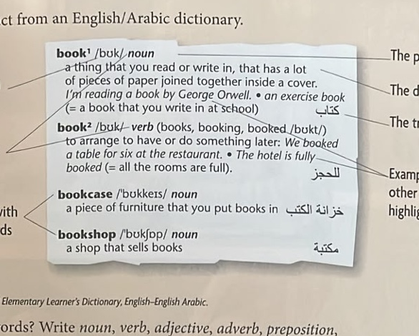
Using a bilingual dictionary: what information can you find?
Students learn to read more than the translation
Dictionary entry parts
Teacher check
• word
• pronunciation
• part of speech
• definition
• translation
• example sentence
• related words
Ask:
“What tells us it is a noun?”
“What tells us it is a verb?”
“Which example helps you use it?”
Kagan: Showdown
Strategy: check part of speech before translating
Unit 1 • Getting to know you
09
Notes:
Timing: 6 minutes.
Kagan Showdown: teacher asks a question, students write an answer quietly, then “show down” answers at the same time.
Emphasize: students should not stop at translation; they should check part of speech and examples.
Language strategy: dictionary strategy — use pronunciation, grammar label, meaning and example together.

Slide 10
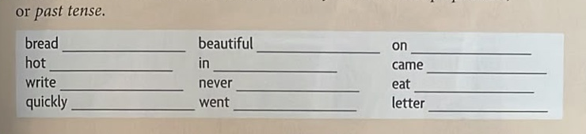
Vocabulary challenge: part of speech sort
Identify word class before using a word
How to decide
1. Can it name a thing? → noun
2. Can it show action? → verb
3. Can it describe a noun? → adjective
4. Can it describe a verb? → adverb
5. Does it show place/time? → preposition
bread — noun
hot — adjective
write — verb
quickly — adverb
beautiful — adjective
in — preposition
never — adverb
went — past tense
on — preposition
came — past tense
eat — verb
letter — noun
RallyRobin prompt
Partner A says a word.
Partner B says the word class and one example sentence. Then switch.
Kagan: RallyRobin
Strategy: classify before using
Unit 1 • Getting to know you
10
Notes:
Timing: 8 minutes.
First attempt: students sort without the answers visible. Use this slide later as feedback/answer key.
Kagan RallyRobin: partners alternate words. If one student is unsure, they say “I think it is…” and explain why.
Language strategy: cognitive classification — grouping words by function supports retention.

Slide 11
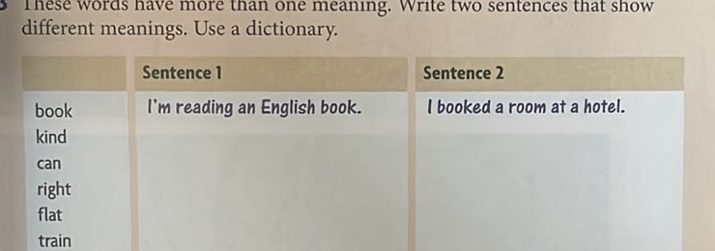
Words with more than one meaning
Use context and examples, not only translation
Quiz-Quiz-Trade
1. Each student gets one word card.
2. Ask a partner for two meanings.
3. Coach if needed.
4. Trade cards and find a new partner.
Word
Meaning 1
Meaning 2
book
I read a book.
I booked a room.
kind
She is kind.
What kind of music?
Language strategy
can
I can swim.
a can of juice
Look at the words around it.
Ask: Is it a noun, verb, adjective or direction?
Use example sentences to confirm.
right
the right answer
Turn right.
flat
a flat road
a flat/apartment
train
a train to Riyadh
train for a race
ring
a gold ring
My phone will ring.
Kagan: Quiz-Quiz-Trade
Strategy: infer meaning from context
Unit 1 • Getting to know you
11
Notes:
Timing: 8 minutes.
Kagan Quiz-Quiz-Trade: students stand, quiz a partner, praise/correct, trade cards, and move on.
Teacher preparation: write each word on a card with one meaning on the back for support.
Language strategy: infer meaning from context and confirm with examples in the dictionary.

Slide 12

Everyday objects: look, label, verify
Use the dictionary for words you do not know
Possible words
Dictionary task
fitness tracker / wristband
comb
gum / chewing gum
tissues / tissue box
scissors
smartphone
notebook
Find 5 things in the room you do not know in English.
Write:
word + pronunciation + translation + example.
Kagan: Find Someone Who
Strategy: word notebook
Unit 1 • Getting to know you
12
Notes:
Timing: 7 minutes.
Students first identify objects in the picture, then look around the room for five unknown words.
Kagan Find Someone Who: students move and ask classmates “Do you know the English word for this?”
Language strategy: vocabulary notebook — record pronunciation, meaning, and example sentence.

Slide 13
Language-learning strategy toolkit
Make students responsible for how they learn
Before speaking
During speaking
• Plan key words
• Practise pronunciation quietly
• Prepare one follow-up question
• Listen for details
• Ask for repetition: “Can you say that again?”
• Use “maybe” when unsure
Using a dictionary
After writing
• Check word class first
• Read the example sentence
• Choose the meaning that fits the context
• Check grammar pattern
• Check punctuation
• Add one interesting detail
Reflection prompt
One strategy I used today was _____. It helped me because _____.
Strategy focus: metacognitive + social + cognitive
Unit 1 • Getting to know you
13
Notes:
Timing: 4 minutes, or use as a mid-lesson pause.
Students select one strategy to use in the final task. This improves ownership and self-regulation.
Ask students to write the reflection prompt after the exit ticket if time allows.

Slide 14
Exit ticket & quick assessment
Evidence of learning before students leave
3 things I can do
Teacher quick rubric
1. Ask a personal question.
2. Identify the part of speech of one word.
3. Use a dictionary example to choose a meaning.
Speaking: asks + answers clearly
Dictionary: identifies correct information
Vocabulary: uses word class accurately
Writing: 5–6 connected sentences
2 new words
Write two new everyday objects from today.
For each: translation + example sentence.
1 question
Write one question you still have.
Kagan: Numbered Heads Together review
Strategy: reflect and set a next goal
Unit 1 • Getting to know you
14
Notes:
Timing: 4 minutes.
Students complete the exit ticket individually. Collect or have students show it at the door.
Kagan review option: before individual writing, use Numbered Heads Together for a quick oral review of the three learning outcomes.
Use rubric evidence to plan the next lesson.

