Slide 1

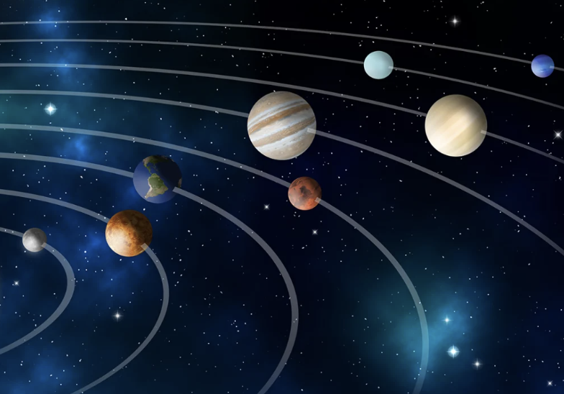
Expat Tales
Reading and Speaking · Unit 1: No place like home
Notes:
Introduce the topic: living abroad. Lesson flow: warm-up, predict, jigsaw reading (Ian / James), language work, speaking.

Slide 2




Why do people go to live abroad?
Work and career
Study
family
Adventure
Make a list of reasons and discuss with your class.
Which is the most common in your country?
Notes:
Exercise 1. Pairs brainstorm, then class feedback. Elicit more reasons beyond these four.

Slide 3
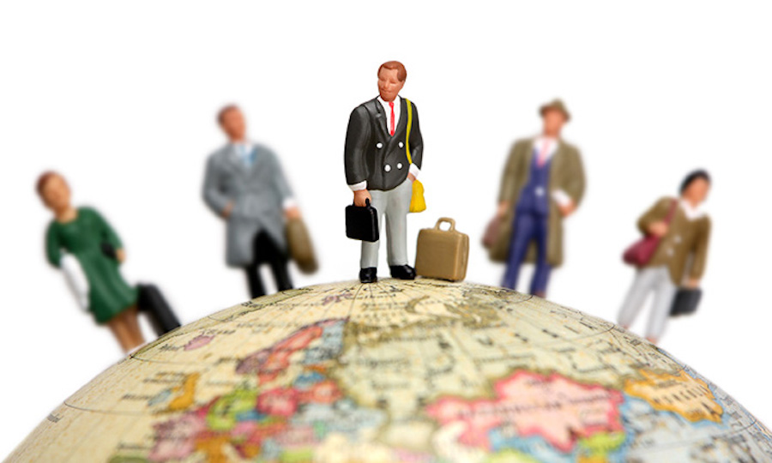


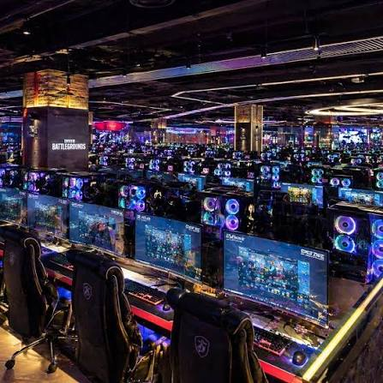
Why do people go to live abroad?
Expat
Astronomical
Observatory
PC bangs
Notes:
Exercise 1. Pairs brainstorm, then class feedback. Elicit more reasons beyond these four.

Slide 4
Before Reading: Chile (C) or Korea (K)?
As we're 2,600 m above sea level, I easily get puffed when I'm exercising.
Soccer is a really big deal here ever since they hosted the 2002 World Cup.
1
2
… we converse in what we call 'Espanglish' …
… learning Chinese characters stinks.
3
4
… its surrounding mines are said to make more money than any other city.
I can eat spicy food like kimchee …
5
6
It's also normal to roll out mattresses and sleep on the floor.
We now have a pleasant walkway along the seafront.
7
8
Notes:
Exercise 2. Students predict who says each line. Answers come after the reading.

Slide 5
Divide into two groups
Group A
Group B
Read about Ian
Read about James
on page 11
on page 12
Read your article
Check your answers to exercise 2
Answer the 10 questions
1
2
3
Notes:
Exercise 3. Split the class. Each group reads its article, then checks exercise 2.

Slide 6



Meet Ian Walker-Smith
From Crewe, England; now lives and works in Chile
4
years in Chile
Married to Andrea, who is Chilean. They have two children
2,600 m
above sea level
Works for a European astronomical agency at Paranal
2 hrs
drive from his family
Shifts: nine days at Paranal, five days' rest at home
Notes:
Group A reads the full article on p.11. This slide is a quick orientation before reading.

Slide 7
Answer the questions about Ian or James
Where did he go to live abroad? Why?
Have there been any difficulties?
1
6
How long has he been there?
In what ways is he 'in the middle of nowhere'?
2
7
What does he do there?
Does he feel at home in his new home?
3
8
What do you learn about his family?
What does he like and dislike about his new life?
4
9
What is the new home town like?
What does he miss?
5
10
Notes:
Exercise 4. Groups answer all 10 questions about their own person.

Slide 8
Check your answers to exercise 2
CHILE (C)
KOREA (K)
2,600 m above sea level
Soccer and the 2002 World Cup
1
2
'Espanglish'
Chinese characters stink
3
4
Mines make more money
Spicy food like kimchee
5
6
Walkway along the seafront
Mattresses on the floor
8
7
Notes:
Click-through reveal is not needed: students compare with their own predictions.

Slide 9
Ian in Chile: answers 1-5
Where? Why?
Chile. At 25 he had 'itchy feet' and wanted to see the world; a colleague pointed out the job.
1
How long?
Four years.
2
What job?
He is in the 12-strong IT team at Paranal Observatory, keeping computers running 24/7 for four huge telescopes.
3
Family?
His wife Andrea is Chilean and they have two children. The family lives in Antofagasta, two hours' drive away.
4
Home town?
Antofagasta is a rich mining town, hardly a tourist spot, but it is improving: a better beach and a seafront walkway.
5
Notes:
Check answers in pairs first, then confirm as a class.

Slide 10
Ian in Chile: answers 6-10
Difficulties?
The language barrier (even lost baggage at first), the altitude, and being far from his family.
6
'Middle of nowhere'?
Paranal is on a mountain in the desert, and his family is a long drive away.
7
Feels at home?
No. After four years he still doesn't feel he belongs; Heathrow felt like home straight away.
8
Likes / dislikes?
Likes: the amazing sky. Dislikes: the language barrier, the altitude and being away from his family.
9
Misses?
Greenery. His own culture still fits him 'like winter gloves'.
10
Notes:
Check answers in pairs first, then confirm as a class.

Slide 11
Language work: Ian in Chile
It takes a real toll
What takes a toll? On whom or what?
Being so far from his family; it is tiring and hard on him.
the computers run 24/7
How long do the computers operate?
24 hours a day, 7 days a week: non-stop.
I easily get puffed
When and why does he get puffed?
When exercising: at 2,600 m the air is thin, so he gets out of breath.
itchy feet
Why did he get itchy feet?
He was 25 and wanted to travel and see the world.
winter gloves
What still fits him like winter gloves?
His own (British) culture.
Notes:
Students explain the meanings to a partner who read the other text.

Slide 12
Language work: James in Korea
I'm really into soccer
Is he a soccer fan?
like soccer very much.
a really big deal
What is a really big deal? Why?
Something very important
doesn't get it
Doesn't understand something.
Who doesn't get what? Why not?
a big shot
An important or powerful person.
Who is a big shot? What makes him one?
was always great fun to be with
Who was always great fun to be with?
Always enjoyable to spend time with.
Then: express the lines marked with an asterisk (*) in more formal English
Notes:
Group B. Use the context in the article on p.12 to explain each expression. Then everybody rewrites the asterisk (*) lines in more formal English.

Slide 13
Find a partner from the other group
Ian: Chile
James: Korea
+ The amazing desert sky
+ A job he enjoys
- Doesn't feel he belongs
- Language barrier and altitude
- Far from his family
Your partner tells you:
+ What does he like?
- What does he dislike?
Does he feel at home?
Who is happier about the move?
Which new home would you prefer?
Notes:
Exercise 5. Compare answers across the groups, then decide who is happier and which home students prefer.

Slide 14

What do you think?
Close your eyes and think about your country.
List disadvantages of moving abroad. For each (-), find an advantage (+).
What would you miss most if you went to live abroad? Compare ideas.
-
The language barrier: maybe you don't speak the language.
+
But this is an opportunity to learn a new language.
Notes:
Work in groups. Plus/minus game: for every disadvantage, find an advantage.

Slide 15


Talk about it
Have any of your friends or family gone to live in a foreign country? Why?
Do you know anyone who has come to live in your country from another country? Why? Do they have any problems?
Which other countries would you like to live in for a while? Why?
Notes:
Free discussion in groups, then feedback.

Slide 16

No place like home
Where would you be happiest: the Chilean desert, Korea, or home?

