Slide 1
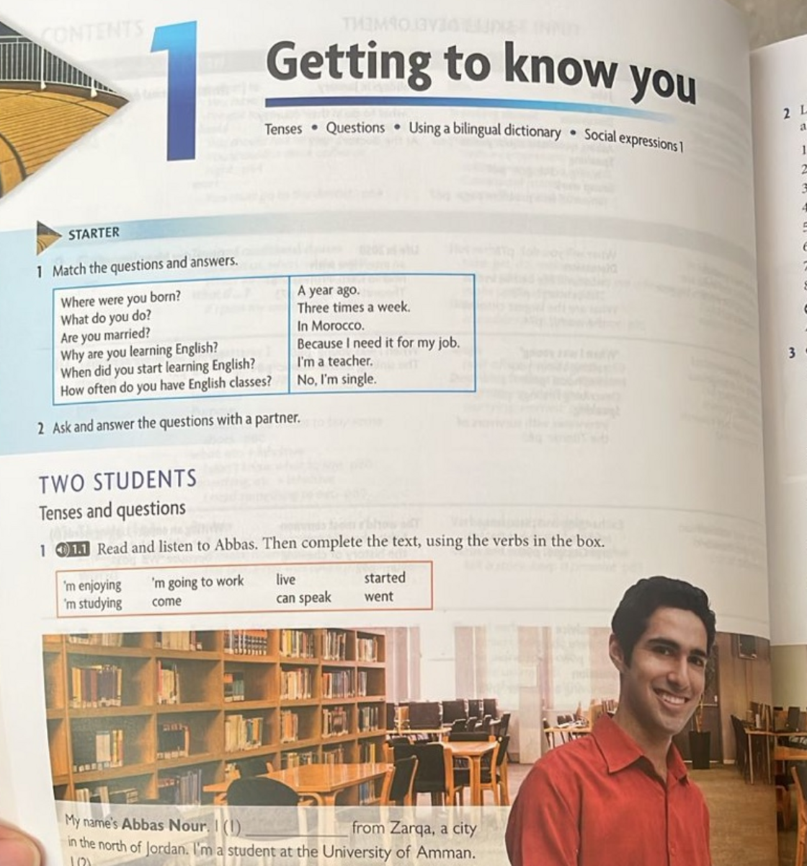
NEW HEADWAY • PRE-INTERMEDIATE
Getting to
Know You
Unit 1 •
Tenses • Questions • Dictionary skills
Communication • Social expressions
Teacher: Maram Alessa
Notes:
افتتاح العرض: اسألي الطالبات What do you want to know about a new person? ثم اعرضي أهداف الوحدة.
[Sources]
- 5B328E8F-BC3E-43C6-8E5C-4388D905E599.jpeg, Unit 1 p. 6 (user-provided book photograph).

Slide 2
UNIT ROADMAP
Lesson Objectives:
1
2
3
introduce yourself
interview a classmate
respond naturally in everyday situations.
Unit 1 — Getting to Know You
2
Notes:
زمن مقترح: 2 دقيقة. وضّحي أن كل حصة تبني على السابقة، وأن الهدف النهائي هو محادثة قصيرة طبيعية.
[Sources]
- John and Liz Soars, New Headway English Course: Pre-Intermediate, Unit 1, pp. 6–13 (user-provided PDF).

Slide 3
01
Getting to Know Me
Name
Place
Hobby
Book
Object
Cartoon
Unit 1 — Slide 3
Notes:
بداية الحصة الأولى. الزمن الإجمالي المقترح: 45 دقيقة.
[Sources]
- John and Liz Soars, New Headway English Course: Pre-Intermediate, Unit 1, p. 6–8 (user-provided PDF).

Slide 4
01
Getting to Know You
Name
Place
Hobby
Book
Object
Cartoon
Unit 1 — Slide 3
Notes:
بداية الحصة الأولى. الزمن الإجمالي المقترح: 45 دقيقة.
[Sources]
- John and Liz Soars, New Headway English Course: Pre-Intermediate, Unit 1, p. 6–8 (user-provided PDF).

Slide 5
LESSON 1 — WARM-UP
Start with six real questions
Match each question to the best answer. Then ask a partner.
QUESTIONS
ANSWERS — MIXED
1 Where were you born?
2 What do you do?
3 Are you married?
4 Why are you learning English?
5 When did you start learning English?
6 How often do you have English classes?
A A year ago.
B Three times a week.
C In Morocco.
D Because I need it for my job.
E I’m a teacher.
F No, I’m single.
Unit 1 — Getting to Know You
4
Notes:
زمن مقترح: 5 دقائق. العمل فردي دقيقة، ثم مقارنة ثنائية، ثم اسألي طالبتين أمام الفصل.
Answer key: 1–C, 2–E, 3–F, 4–D, 5–A, 6–B.
[Sources]
- 5B328E8F-BC3E-43C6-8E5C-4388D905E599.jpeg, Unit 1 p. 6 (user-provided book photograph).

Slide 6
LESSON 1 — CHECK
The answer tells you the question type
WHERE
In Morocco.
WHAT
I’m a teacher.
ARE
No, I’m single.
WHY
Because I need it for my job.
WHEN
A year ago.
HOW OFTEN
Three times a week.
Now choose two questions and give your own answers.
Unit 1 — Getting to Know You
5
Notes:
راجعي الإجابات بسرعة. ركزي على العلاقة بين كلمة السؤال ونوع الإجابة.
[Sources]
- 5B328E8F-BC3E-43C6-8E5C-4388D905E599.jpeg, Unit 1 p. 6 (user-provided book photograph).

Slide 7
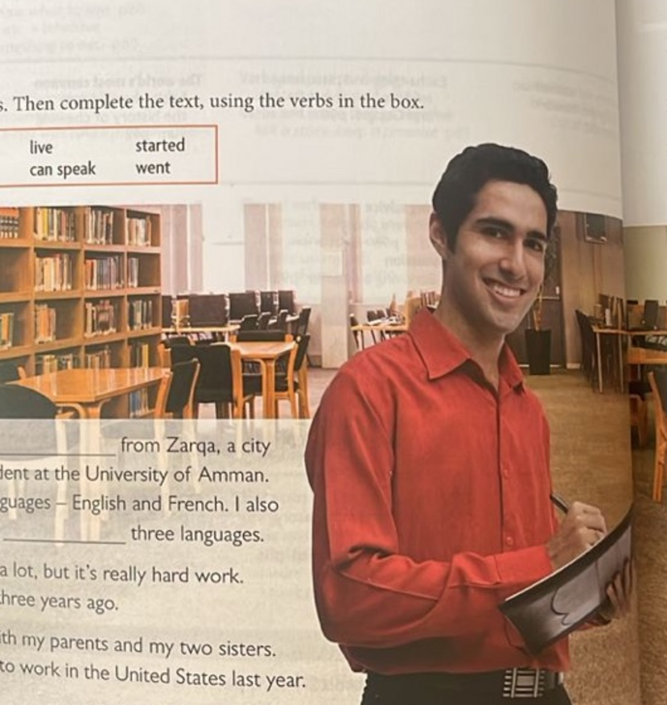
LESSON 1 — TENSE HUNT
Meet Abbas Nour
WORD BANK
come • ’m studying • can speak • ’m enjoying
started • live • went • ’m going to work
1 I ______ from Zarqa.
2 I ______ modern languages.
3 I ______ three languages.
4 I ______ the course.
5 The course ______ three years ago.
6 I ______ at home with my family.
7 Last year my brother ______ to the US.
8 After graduation, I ______ as a translator.
Unit 1 — Getting to Know You
6
Notes:
زمن مقترح: 7 دقائق. اطلبي تحديد كلمات الزمن قبل اختيار الفعل.
Answer key: 1 come; 2 ’m studying; 3 can speak; 4 ’m enjoying; 5 started; 6 live; 7 went; 8 ’m going to work.
[Sources]
- 5B328E8F-BC3E-43C6-8E5C-4388D905E599.jpeg, Unit 1 p. 6 (user-provided book photograph).

Slide 8
LESSON 1 — ANSWER KEY
Abbas uses four time frames
PRESENT SIMPLE
come • can speak • live
facts and routines
PRESENT CONTINUOUS
’m studying • ’m enjoying
happening around now
PAST SIMPLE
started • went
finished past events
FUTURE PLAN
’m going to work
an intention after graduation
Which time frame describes you today? Give one true sentence.
Unit 1 — Getting to Know You
7
Notes:
الإجابات ظاهرة. اطلبي من الطالبات تصنيف الأفعال ثم كتابة جملة شخصية لكل زمن.
[Sources]
- 5B328E8F-BC3E-43C6-8E5C-4388D905E599.jpeg, Unit 1 p. 6 (user-provided book photograph).

Slide 9
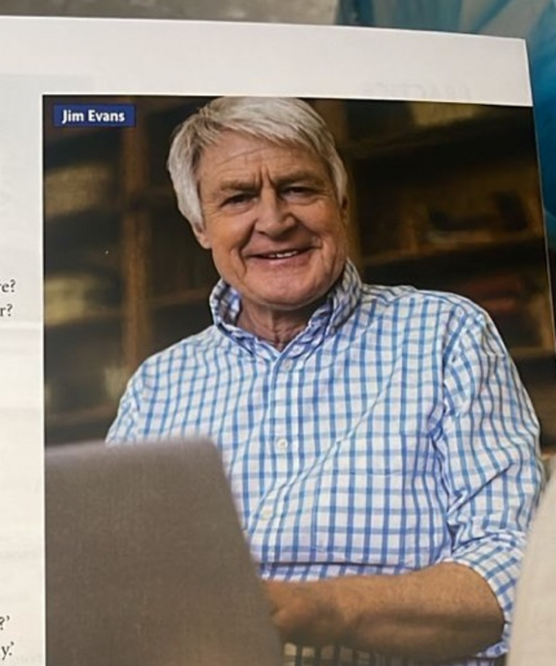
LESSON 1 — QUESTION FORMS
Build questions about Jim
Complete the missing words.
1 Where does he come from?
2 Where ______ he live?
3 Who ______ he live with?
4 What ______ he do before he retired?
5 When ______ he leave school?
6 What ______ he studying?
7 How many children ______ he have?
8 What ______ he going to do next year?
Unit 1 — Getting to Know You
8
Notes:
زمن مقترح: 5 دقائق. Answer key: 2 does; 3 does; 4 did; 5 did; 6 is; 7 does; 8 is.
[Sources]
- 905A028E-ED29-4FAE-BF27-8248E39AC285.jpeg, Unit 1 p. 7 (user-provided book photograph).

Slide 10
LESSON 1 — LISTENING CHECK
Jim’s answers show his present, past, and plan
LIFE NOW
TIME & FUTURE
• Retired; now a student
• Studies at home, not at a university
• Enjoys the course
• Is writing an essay at the moment
• Left school at 15
• His family needed the money
• Will visit his son and his wife next year
• They live in Spain
Partner challenge
Ask one follow-up question that is not in the book.
Example: What is your essay about?
Unit 1 — Getting to Know You
9
Notes:
استخدمي الإجابات الظاهرة في الحوارات لتمييز الحاضر والماضي والخطة المستقبلية، ثم اطلبي سؤال متابعة جديدًا.
[Sources]
- 905A028E-ED29-4FAE-BF27-8248E39AC285.jpeg, Unit 1 p. 7 (user-provided book photograph).

Slide 11
LESSON 1 — GRAMMAR MAP
Time words point to the tense
PAST
ROUTINE / FACT
NOW
PLAN
last year
three years ago
usually
every week
at the moment
today
after I graduate
next year
My brother went…
I live at home.
I’m studying…
I’m going to…
Listen for the time clue before you choose the verb form.
Unit 1 — Getting to Know You
10
Notes:
زمن مقترح: 5 دقائق. استخدمي الخط الزمني لتمييز الأزمنة الأربعة.
[Sources]
- John and Liz Soars, New Headway English Course: Pre-Intermediate, Unit 1, p. 6–7 (user-provided PDF).

Slide 12
LESSON 1 — GRAMMAR FOCUS
Present simple states a fact; continuous shows a temporary situation
PRESENT SIMPLE
PRESENT CONTINUOUS
FORM
subject + base verb / -s
USE
facts • routines • permanent situations
He lives with his parents.
FORM
subject + am / is / are + verb-ing
USE
now • around now • temporary situations
She’s living with an English family for a month.
Unit 1 — Getting to Know You
11
Notes:
اسألي: Which sentence sounds permanent? Which is temporary? ثم اطلبي مثالين من واقع الطالبات.
[Sources]
- John and Liz Soars, New Headway English Course: Pre-Intermediate, Unit 1, p. 7 (user-provided PDF).

Slide 13
LESSON 1 — GRAMMAR FOCUS
Build questions in a reliable order
QUESTION WORD
AUXILIARY
SUBJECT
MAIN VERB
Where / What / When
do / does / did / is
you / he / the course
live / start / study
Where + does + he + live?
With be, move be before the subject: What is he studying?
Unit 1 — Getting to Know You
12
Notes:
ركزي على اختيار الفعل المساعد حسب الزمن، ثم عودة الفعل الرئيسي إلى المصدر بعد do/does/did.
[Sources]
- 905A028E-ED29-4FAE-BF27-8248E39AC285.jpeg, Unit 1 p. 7 (user-provided book photograph).

Slide 14
LESSON 1 — CHALLENGE
Choose the question word from the answer
Write the best question word for each answer.
1–5
6–10
1 ______? A sandwich.
2 ______? Jack.
3 ______? In Riyadh.
4 ______? Last night.
5 ______? Because I wanted to.
6 ______? Four.
7 ______? $5.
8 ______? By bus.
9 ______? It’s mine.
10 ______? The black one.
Bonus: turn any three answers into complete questions.
Unit 1 — Getting to Know You
13
Notes:
Answer key: 1 What; 2 Who; 3 Where; 4 When; 5 Why; 6 How many; 7 How much; 8 How; 9 Whose; 10 Which.
[Sources]
- 905A028E-ED29-4FAE-BF27-8248E39AC285.jpeg, Unit 1 p. 7 (user-provided book photograph).

Slide 15
LESSON 1 — CLOSE
Exit ticket: three sentences, three time frames
Before you leave, write…
01
a true fact about you
I live… / I speak…
02
something you did last week
I went… / I watched…
03
a plan for next year
I’m going to…
Unit 1 — Getting to Know You
14
Notes:
زمن مقترح: 4 دقائق. اجمعي التذاكر أو اختاري ثلاث إجابات للتصحيح الشفهي.
[Sources]
- John and Liz Soars, New Headway English Course: Pre-Intermediate, Unit 1, p. 6–8 (user-provided PDF).

Slide 16
02
Explore Meaning
LESSON
Use English to exchange information, understand word classes, and explore how communication works.
Unit 1 — Slide 15
Notes:
بداية الحصة الثانية. الزمن الإجمالي المقترح: 45 دقيقة.
[Sources]
- John and Liz Soars, New Headway English Course: Pre-Intermediate, Unit 1, p. 8–11 (user-provided PDF).

Slide 17
LESSON 2 — SPEAKING
Ask for the information you need
TALK ABOUT YOU
INFORMATION GAP
Ask your partner:
• Where do you live?
• Do you have brothers or sisters?
• What do you like doing at the weekend?
• Where did you go for your last holiday?
Student A knows WHY Jack rides a bike.
Student B knows WHEN he started.
Ask, answer, and complete the missing information.
Useful questions
When did he start…?
Why does he ride…?
Unit 1 — Getting to Know You
16
Notes:
زمن مقترح: 8 دقائق. إجابات Jack: Thirty years ago, when he was 22. Because he delivers letters to a lot of small villages.
[Sources]
- 56B91C03-37ED-4039-A393-E9285E8D6D98.jpeg, Unit 1 p. 8 (user-provided book photograph).

Slide 18
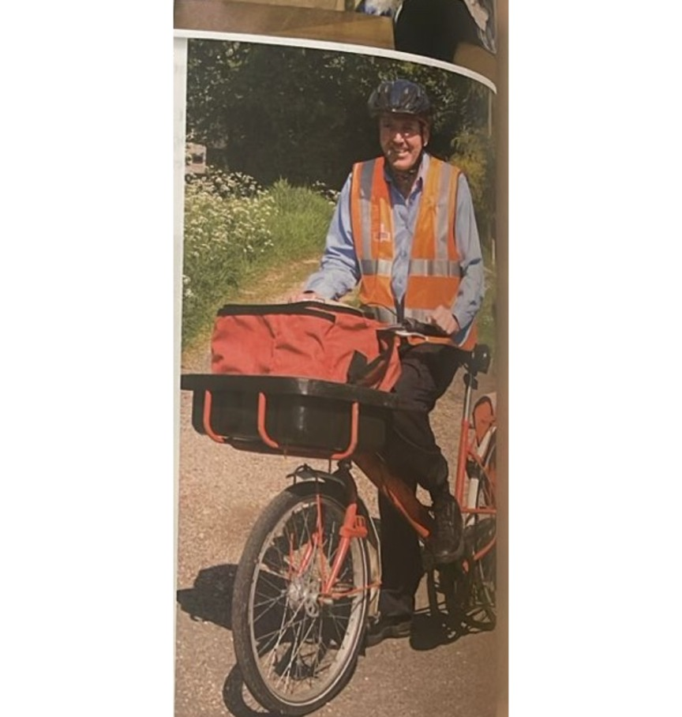
LESSON 2 — INFORMATION GAP
Ask for the missing detail—not the whole story
STUDENT A KNOWS
He rides a bike because he delivers letters to a lot of small villages.
Ask: When did he start working as a postman?
STUDENT B KNOWS
He started thirty years ago, when he was 22.
Ask: Why does he ride a bike?
Unit 1 — Getting to Know You
17
Notes:
وزعي الأدوار دون أن يرى كل طالب معلومات الآخر. بعد السؤالين، يروي كل زوج قصة Jack كاملة.
[Sources]
- 56B91C03-37ED-4039-A393-E9285E8D6D98.jpeg, Unit 1 p. 8 (user-provided book photograph).

Slide 19
LESSON 2 — GRAMMAR PRACTICE
Choose the verb form that fits
1 Hassan comes / is coming from Oman.
2 He speaks / is speaking Arabic and French.
3 Today Tom wears / is wearing jeans and a T-shirt.
4 Are you liking / Do you like black coffee?
5 Last year she went / goes on holiday to Florida.
6 Next year she studies / is going to study at university.
Underline the time clue or meaning clue in each sentence.
Unit 1 — Getting to Know You
18
Notes:
زمن مقترح: 5 دقائق. Answer key: 1 comes; 2 speaks; 3 is wearing; 4 Do you like; 5 went; 6 is going to study.
[Sources]
- 56B91C03-37ED-4039-A393-E9285E8D6D98.jpeg, Unit 1 p. 8 (user-provided book photograph).

Slide 20
LESSON 2 — ANSWER KEY
The clues confirm all six choices
01
comes
origin / fact
02
speaks
ability / fact
03
is wearing
today / now
04
Do you like
state verb
05
went
last year
06
is going to study
next year / plan
Explain one answer using the word because.
Unit 1 — Getting to Know You
19
Notes:
راجعي ليس فقط الإجابة بل سبب الاختيار. نموذج: We use went because last year shows a finished past time.
[Sources]
- 56B91C03-37ED-4039-A393-E9285E8D6D98.jpeg, Unit 1 p. 8 (user-provided book photograph).

Slide 21
LESSON 2 — VOCABULARY
Classify words with a dictionary
Classify each word: noun, verb, adjective, adverb, preposition, or past tense.
bread
beautiful
on
hot
in
came
write
never
eat
quickly
went
letter
Dictionary codes: n. noun • v. verb • adj. adjective • adv. adverb • prep. preposition
Unit 1 — Getting to Know You
20
Notes:
زمن مقترح: 6 دقائق. Answer key: bread n.; beautiful adj.; on prep.; hot adj.; in prep.; came past tense; write v.; never adv.; eat v.; quickly adv.; went past tense; letter n.
[Sources]
- John and Liz Soars, New Headway English Course: Pre-Intermediate, Unit 1, p. 9 (user-provided PDF).

Slide 22
LESSON 2 — VOCABULARY CHECK
One spelling can carry more than one meaning
ANSWER KEY
TWO MEANINGS
NOUN bread • letter
VERB write • eat
ADJECTIVE beautiful • hot
ADVERB never • quickly
PREPOSITION on • in
PAST TENSE came • went
book
I’m reading a good book.
I booked a room.
Now write two sentences for one word:
kind • can • mean • flat • play • train • ring
Unit 1 — Getting to Know You
21
Notes:
نماذج المعاني موجودة في T1.3. اتركي دقيقتين لكتابة مثالين ثم مشاركة مثال واحد.
[Sources]
- John and Liz Soars, New Headway English Course: Pre-Intermediate, Unit 1, p. 9; tapescript p. 118 (user-provided PDF).

Slide 23
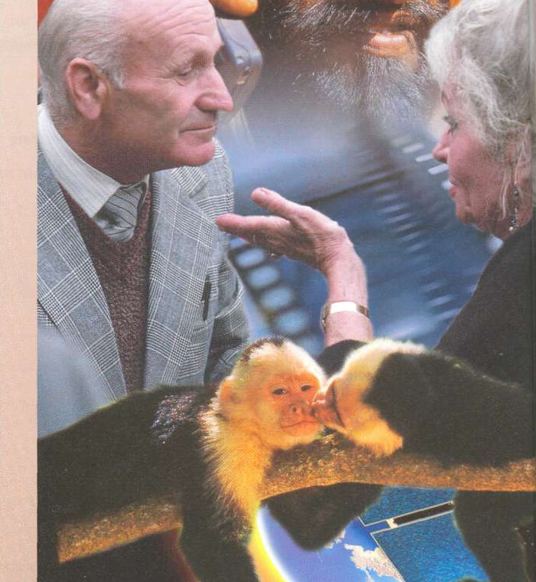
LESSON 2 — READING
Communication goes beyond spoken language
Before reading
How many ways can people communicate?
Mime one idea.
Your partner guesses—no words allowed.
Reading prediction
People • animals • history • technology
Unit 1 — Getting to Know You
22
Notes:
زمن مقترح: 5 دقائق. نشاط تمهيدي: mime ثم قراءة سريعة لتحديد موضوع كل فقرة.
[Sources]
- John and Liz Soars, New Headway English Course: Pre-Intermediate, Unit 1, p. 10 (user-provided PDF).

Slide 24
LESSON 2 — READING INSIGHT
Animals exchange signals; humans build complex meaning
ANIMAL SIGNALS
HUMAN LANGUAGE
• Bees dance to show where food is.
• Elephants make sounds humans cannot hear.
• Whales sing.
• Monkeys use facial expressions for anger and love.
People can:
• write poetry and tell jokes
• make promises and explain
• persuade, tell truth, or tell lies
• communicate past, present, and future
Discuss: What can animals do that people cannot?
Unit 1 — Getting to Know You
23
Notes:
اطلبي من كل مجموعة اختيار مثال واحد للحيوانات ومثال واحد يميز التواصل البشري.
[Sources]
- John and Liz Soars, New Headway English Course: Pre-Intermediate, Unit 1, p. 11 (user-provided PDF).

Slide 25
LESSON 2 — READING TIMELINE
Communication tools changed societies
c. 2900 BC
ANCIENT
ANCIENT
14th c.
NOW
EGYPT
GREECE
ROME
EUROPE
GLOBAL
paper +
hieroglyphics
public speaking +
drama
Roman alphabet +
government
printing press +
new ideas
Internet +
instant information
Today’s challenge: more information makes it harder to decide what matters.
Unit 1 — Getting to Know You
24
Notes:
زمن مقترح: 6 دقائق. اطلبي من الطالبات وصف أثر واحد لكل مرحلة. ذكّري أن النص يذكر radio, film, and television قبل Internet.
[Sources]
- John and Liz Soars, New Headway English Course: Pre-Intermediate, Unit 1, p. 11 (user-provided PDF).

Slide 26
LESSON 2 — COMPREHENSION
Reading check: support every answer with evidence
1
Which animals are mentioned, and what can each do?
2
What is special about human communication?
3
Which four forms of media appear in the last paragraph?
4
What is one benefit and one drawback of information technology?
Use a phrase from the text—not only your opinion.
Unit 1 — Getting to Know You
25
Notes:
Answer key: 1 bees—dance/food; elephants—inaudible sounds; whales—sing; monkeys—faces. 2 complex language, many purposes, and time. 3 radio, film, television, Internet. 4 fast access to much information, but overload makes importance difficult to judge.
[Sources]
- John and Liz Soars, New Headway English Course: Pre-Intermediate, Unit 1, p. 10–11 (user-provided PDF).

Slide 27
LESSON 2 — CLOSE
Exit ticket: meaning changes with context
WORD
SENTENCE 1
SENTENCE 2
Choose one:
kind • can • mean • flat • play • train • ring
Write a sentence that shows meaning A.
Write a different sentence that shows meaning B.
Underline the clues that reveal each meaning.
Unit 1 — Getting to Know You
26
Notes:
زمن مقترح: 4 دقائق. مثال: The phone is ringing. / She is wearing a ring.
[Sources]
- John and Liz Soars, New Headway English Course: Pre-Intermediate, Unit 1, p. 9 (user-provided PDF).

Slide 28
03
Connect Socially
LESSON
Compare viewpoints, solve a neighbourly misunderstanding, and respond naturally in social situations.
Unit 1 — Slide 27
Notes:
بداية الحصة الثالثة. الزمن الإجمالي المقترح: 45 دقيقة.
[Sources]
- John and Liz Soars, New Headway English Course: Pre-Intermediate, Unit 1, p. 12–13 (user-provided PDF).

Slide 29
LESSON 3 — WARM-UP
Your ideal neighbour may be different from mine
Vote YES or NO, then explain one choice.
My ideal neighbours…
• say hello when I see them.
• have parties and invite me.
• are very quiet.
• often come round for coffee.
• borrow things sometimes.
• make themselves at home in my house.
GOOD WALLS
MAKE GOOD
NEIGHBOURS
Agree or disagree?
Unit 1 — Getting to Know You
28
Notes:
زمن مقترح: 6 دقائق. نفذي التصويت برفع اليد، ثم اختاري رأيين مختلفين للتبرير.
[Sources]
- John and Liz Soars, New Headway English Course: Pre-Intermediate, Unit 1, p. 12 (user-provided PDF).

Slide 30
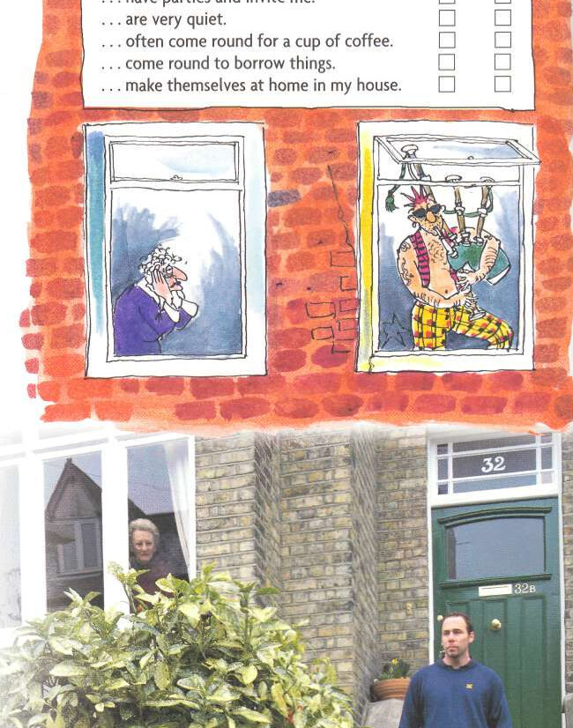
LESSON 3 — LISTENING VIEWPOINTS
One building, two very different stories
MRS SNELL SAYS
STEVE SAYS
• Steve may be a builder.
• His job cannot be very good.
• His girlfriend lives with him.
• The party had 40 people and lasted until 2 a.m.
• She will not speak until introduced.
• He works in advertising.
• The work is hard, long, and well paid.
• His sister is staying while job-hunting.
• About 10 people left for a club at 11 p.m.
• He thinks Mrs Snell dislikes young people.
Unit 1 — Getting to Know You
29
Notes:
بعد الاستماع T1.4 وT1.5، اطلبي تلوين الحقائق المشتركة وتحديد الافتراضات. نقطة مهمة: girlfriend عند Mrs Snell، لكنها sister بحسب Steve.
[Sources]
- John and Liz Soars, New Headway English Course: Pre-Intermediate, Unit 1, p. 12; tapescript p. 118 (user-provided PDF).

Slide 31
LESSON 3 — LISTENING CHECK
Listen for facts and disagreements
1–5
6–10
1 When did Steve move in?
2 Is the flat large?
3 What is his job? Is it good?
4 Does he work long hours?
5 What does he wear for work?
6 Who is staying with Steve?
7 What time did the party end?
8 How many people came?
9 What is Steve doing tonight?
10 Why won’t Mrs Snell speak to him?
Mark an answer ★ when the two speakers disagree.
Unit 1 — Getting to Know You
30
Notes:
Answer key: 1 a few weeks ago; 2 no, one bedroom; 3 advertising, hard but well-paid/relaxed; 4 yes; 5 jeans and T-shirt (Mrs Snell’s observation); 6 his sister; 7 ★ 2 a.m. vs 11 p.m. at the flat; 8 ★ 40 vs about 10; 9 visiting a friend in hospital, then Chinese meal; 10 nobody introduced them.
[Sources]
- John and Liz Soars, New Headway English Course: Pre-Intermediate, Unit 1, p. 12; tapescript p. 118 (user-provided PDF).

Slide 32
LESSON 3 — ROLEPLAY
Reset the story over coffee
A — STEVE
B — MRS SNELL
C — NEIGHBOUR
Explain your job, your sister, and what happened after 11 p.m.
Explain the noise, your assumptions, and why you did not answer.
Keep the conversation polite. Ask both people for details.
Opening line
Do you two know each other?
Goal: reach one agreement before the conversation ends.
Unit 1 — Getting to Know You
31
Notes:
زمن مقترح: 10 دقائق. 2 للتحضير، 5 للتمثيل، 3 لتغذية راجعة على الأسئلة والتعبيرات المهذبة.
[Sources]
- John and Liz Soars, New Headway English Course: Pre-Intermediate, Unit 1, p. 12 (user-provided PDF).

Slide 33
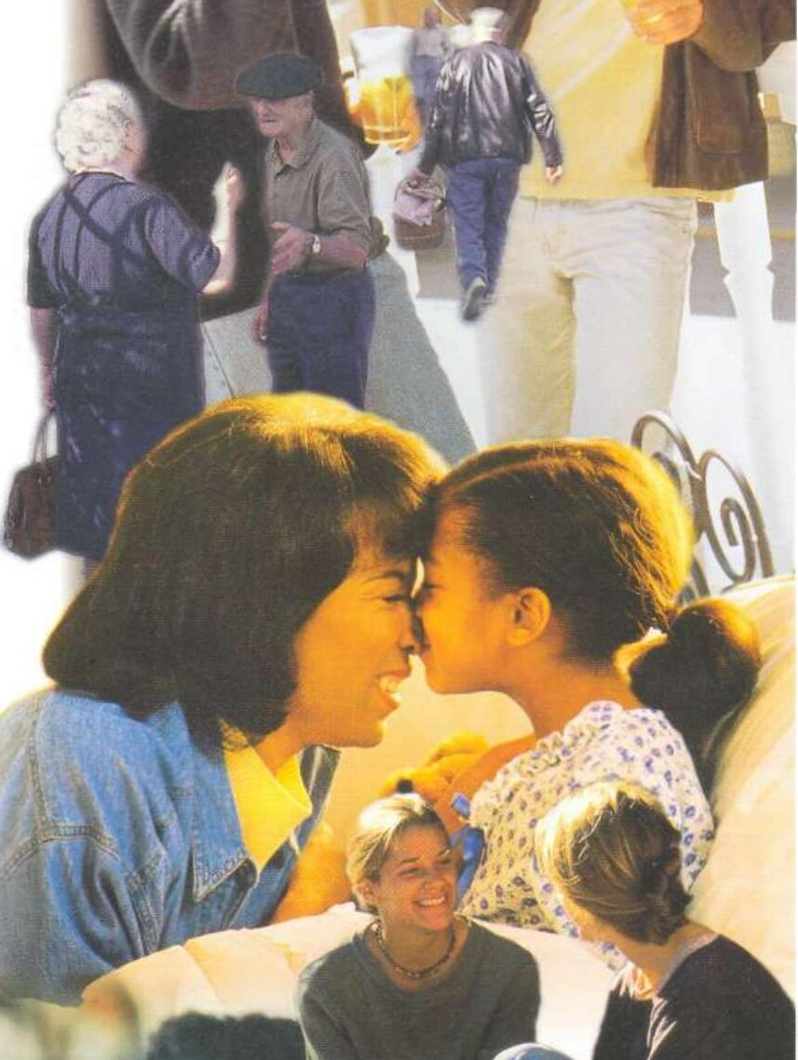
LESSON 3 — EVERYDAY ENGLISH
Match expressions and responses
Match each expression to a response.
1 How are you?
2 Hello, Jane!
3 How do you do?
4 See you tomorrow!
5 Good night!
6 Excuse me!
7 Bless you!
8 Have a good weekend!
A Bye!
B Same to you!
C Fine, thanks.
D Yes. Can I help you?
E How do you do?
F Hi, Peter!
G Sleep well!
H Thanks.
Unit 1 — Getting to Know You
32
Notes:
زمن مقترح: 5 دقائق. Answer key: 1–C, 2–F, 3–E, 4–A, 5–G, 6–D, 7–H, 8–B.
[Sources]
- John and Liz Soars, New Headway English Course: Pre-Intermediate, Unit 1, p. 13 (user-provided PDF).

Slide 34
LESSON 3 — ANSWER KEY
The right response depends on the situation
How are you? → Fine, thanks.
Hello, Jane! → Hi, Peter!
How do you do? → How do you do?
See you tomorrow! → Bye!
Good night! → Sleep well!
Good morning! → Good morning!
Hello, I’m Ela. → Pleased to meet you.
Cheers! → Cheers!
Excuse me! → Yes. Can I help you?
Bless you! → Thanks.
Have a good weekend! → Same to you!
Thank you very much. → Not at all.
Make yourself at home. → That’s very kind.
Practise the pairs with natural stress and eye contact.
Unit 1 — Getting to Know You
33
Notes:
التعبيرات الكاملة من T1.6. اعملي تدريب سلسلة: طالبة تقول التعبير والتالية ترد فورًا.
[Sources]
- John and Liz Soars, New Headway English Course: Pre-Intermediate, Unit 1, p. 13; tapescript p. 118 (user-provided PDF).

Slide 35
UNIT 1 — PERFORMANCE TASK
Create a two-minute conversation
In pairs, create a conversation that includes:
CONTENT
SUCCESS CHECK
• a greeting
• two personal questions
• one present fact
• one past event
• one future plan
• a natural goodbye
□ Questions are in the right order.
□ Verb forms match the time.
□ Both partners speak.
□ Responses sound natural.
□ The conversation has a clear ending.
Be ready to perform without reading every word.
Unit 1 — Getting to Know You
34
Notes:
زمن مقترح: 12 دقيقة. 5 كتابة، 4 تدريب، 3 أداء مجموعتين. استخدمي قائمة النجاح للتقييم السريع.
[Sources]
- John and Liz Soars, New Headway English Course: Pre-Intermediate, Unit 1, p. 6–13 (user-provided PDF).

Slide 36
UNIT 1 — FINAL REVIEW
You can now introduce, interview, and respond
Can-do checklist
□ I can ask personal questions.
□ I can use present simple and continuous.
□ I can describe a finished past event.
□ I can talk about a future plan.
□ I can use a dictionary to identify word class.
□ I can compare two viewpoints.
□ I can respond to everyday social expressions.
ASK
LISTEN
CONNECT
Choose one skill to practise again this week.
Unit 1 — Getting to Know You
35
Notes:
ختام الوحدة. اطلبي تقييمًا ذاتيًا: green = confident, amber = need more practice. لا تنهي بكلمة شكر؛ اربطي الإغلاق بهدف التواصل الحقيقي.
[Sources]
- John and Liz Soars, New Headway English Course: Pre-Intermediate, Unit 1, p. 6–13 (user-provided PDF).

